Slide 1
Introduction
CSC3113: Theory of Computation
8
4
Fall 2023-2024
Dr. Afroza Nahar
Department of Computer Science, Faculty of Science & Technology.
afroza@aiub.edu room no. DN 0113

Slide 2
Overview
Regular expressions
Equivalence of RE and RL

Slide 3
Regular Expressions
Regular languages (RL) are often described by means of algebraic expressions called regular expressions (RE).
In arithmetic we use the +, * operations to construct expressions: (2+3)*5
The value of the arithmetic expression is the number 25.
The value of a regular expression is a regular language.

Slide 4
Regular operations
In RE we use regular operations to construct expressions describing regular languages: ( 0 + 1 ) * ◦ 0
where :
r+s means r OR s
r* means Kleene star of r
r◦s (or rs) means concatenation of r and s

Slide 5
Regular Expressions
Regular languages (RL) are often described by means of algebraic expressions called regular expressions (RE).
we use three operations
union ∪
concatenation
Kleene star (*) [cleany star]
• The value of a regular expression is a regular language.

Slide 6
Union ∪ ( disjunction, OR, |, +)
The union of languages is the usual thing, since languages are sets.
Example: {01,111,10} ∪ {00, 01}
= {01,111,10,00}.
01 happens to be in both sets, so it will be once in the union

Slide 7
Concatenation: represented by juxtaposition (no punctuation) or middle dot ( · )
The concatenation of languages L and M is denoted LM.
It contains every string wx such that w is in L and x is in M.
Example: {01,111,10}{00, 01} = {0100, 0101, 11100, 11101, 1000, 1001}.

Slide 8
Kleene Star: represented by an asterisk aka star (*)
If L is a language, then L*, the Kleene star or just “star,” is the set of strings formed by concatenating zero or more strings from L, in any order.
L* = {ε} ∪ L ∪ LL ∪ LLL ∪ …
Example: {0,10}* = {ε, 0, 10, 00, 010, 100, 1010,…} If you take no strings from L, that would give you the empty string.

Slide 9
Formal definition
A set of regular expressions over an alphabet Σ is defined inductively as follows:
Basis: ε, φ, and σ (for all σ ∈ Σ, ) are regular expressions.
Induction: If r and s are RE then the following expressions are also RE:
(r)
r+s
r◦s
r*

Slide 10
Regular expressions and regular languages
A Regular Expression can be recursively defined as follows −
ε is a Regular Expression indicates the language containing an empty string. (L (ε) = {ε})
φ is a Regular Expression denoting an empty language. (L (φ) = { })
x is a Regular Expression where L = {x}

Slide 11
Regular expressions and regular languages
If X is a Regular Expression denoting the language L(x) and Y is a Regular Expression denoting the language L(Y), then
X + Y is a Regular Expression corresponding to the language L(X) ∪ L(Y) where L(X+Y) = L(X) ∪ L(Y).
X . Y is a Regular Expression corresponding to the language L(X) . L(Y) where L(X.Y) = L(X) . L(Y)
R* is a Regular Expression corresponding to the language L(R*)where L(R*) = (L(R))*
If we apply any of the rules several times from 1 to 5, they are Regular Expressions.

Slide 12
Examples over Σ ={a,b}
ε, a, a+b, b*, (a+b)b, ab*, a*+b*
To avoid using many parentheses, the operations have the following priority hierarchy:
1. * - highest (do it first)
2. ◦
3. + - lowest (do it last)
Example: (b+(a◦(b*)) = b + ab*
(Notations: The symbol ◦ can be dropped. Σ means (σ₁ + σ₂ + σ₃…) , r+ means rr * ).

Slide 13
Regular expressions and regular languages
We associate each regular expression r with a regular language L(r) as follows:
L(φ)= φ,
L(ε)={ε},
L(σ)={σ} for each σ ∈Σ,
L(r+s)=L(r) U L(s),
L(r◦s)=L(r)◦L(s),
L(r*)=(L(r))*.

Slide 14
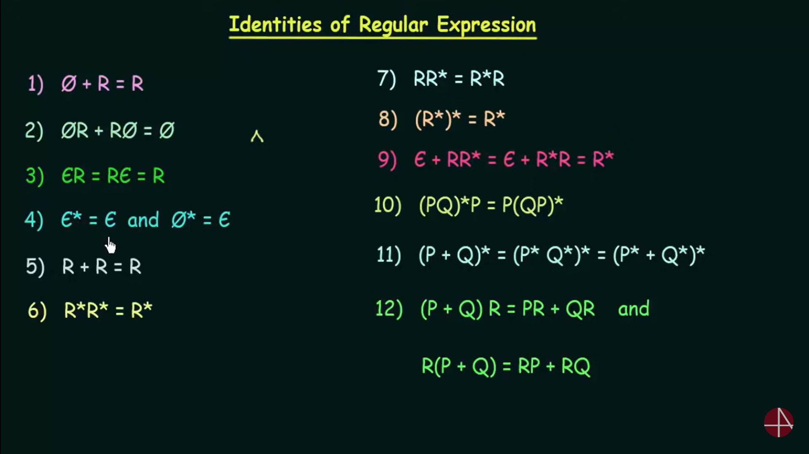

Slide 15
Converting a regular expression to an NFA
Example 2: Convert the following Regular Expression into equivalent NFA using formal procedure (ab∪ a)*
Example 3: Convert the following Regular Expression into equivalent NFA using formal procedure 0(1 ∪ 01*) ∪ 0*1*

Slide 16
Equivalences so far…
Regular Languages
DFA
Regular Expressions
NFA

Slide 17
Examples :Describe each language as a regular expression over Σ ={0,1}
0∗10∗
Σ*1Σ*
Σ*110Σ*
(Σ Σ)*
1(0+1)*
(0+1)*00
1*(01111*)*
0*(1000)*
1*0 1*01*0⁺
(ΣΣΣ)∗
0*(100*)*
L = { w | w has a single 1}
L = { w | w has at least one 1}
L = { w | w contains the string 110}
L = { w | |w| mod 2 =0}
L = { w | w starts with 1}
L6 = { w | w ends with 00}
L7 = {w | each 0 in w is followed by at least three 1’s}
{w | each 1 in w is followed by exactly three 0’s}
{w | w contains at least three 0’s and ends with 0}
{w|w the length of w is a multiple of 3}
w | w does not contain consecutive 1’s

Slide 18
Examples: over Σ ={x,y}
L = { w | w contains the string xyx or the string yxy }
(x+y)*xyx (x+y)* + (x+y)* yxy (x+y)*
L = { w | w starts and ends with the same letter }:
[ x+xΣ∗x] + [y+yΣ∗y]
L = {w | w contains exactly three y’s and ends with x}
x*yx*yx*yx⁺
over Σ ={0, 1}
L = The set of strings of 0’s and 1’s whose tenth symbol from the right end is 1.
(0 + 1)*1(0 + 1)⁹
L = The set of strings of 0’s and 1’s with at most one pair of consecutive 1’s.
(0 + 10)*(11 + ε)(0 + 10)*

Slide 19
RL to RE
Give a regular expression for the following languages:
Σ = {a,b}: The set of all strings where the second letter from the start and the end is an a.
Answer: (a + b)a(a + b)*a(a + b)
Σ = {a,b}: The set of all strings that have both aa and bb as a substring.
Answer: ((a + b)*aa(a + b)∗bb(a + b)∗) + ((a + b)∗bb(a + b)∗aa(a + b)∗)
Σ = {a,b,c}: The set of all strings, such that between any a and c there's at least one b.
Answer: ((ε + aa∗ + cc∗)b)*(ε + aa∗ + cc∗)

Slide 20
All strings that contain an even number of b’s.
a∗(ba∗ba∗)∗
All strings which do not contain the substring ba.
a∗b∗
The set of all strings where the second letter from L.H.S and the end is an a
(a + b) a (a + b)* a (a + b)

Slide 21
Properties of regular expressions 1
Useful properties of regular expressions:
r+s=s+r
r+ φ = φ +r=r
r+r=r
r φ = φ r= φ
rr * =r+
rε = εr=r

Slide 22
Properties of regular expressions
r(s+t)=rs+rt
r+(s+t)=(r+s)+t
r(st)=(rs)t
r*=(r*)*=r*r*=r*+r
r*+r+=r*

Slide 23
Properties of regular expressions
If we let R be any regular expression, we have the following identities. They are good tests of whether you understand the deﬁnition.
R∪∅= R. Adding the empty language to any other language will not change it.
R◦ε = R. Joining the empty string to any string will not change it.

Slide 24
Joining the empty string to any string will not change it.
However, exchanging ∅ and ε in the preceding identities may cause the equalities to fail.
R∪ε may not equal R.
For example, if R = 0, then
L(R)={0}but L(R∪ε)={0,ε}.
R◦∅ may not equal R.
For example, if R = 0, then L(R)={0}but L(R◦∅)=∅.

Slide 25
Equivalences so far…
Regular Languages
DFA
Regular Expressions
NFA

Slide 26
Regular Expressions | Regular Set
(0 + 10*) | L = { 0, 1, 10, 100, 1000, 10000, … }
(0*10*) | L = {1, 01, 10, 010, 0010, …}
(0 + ε)(1 + ε) | L = {ε, 0, 1, 01}
(a+b)* | Set of strings of a’s and b’s of any length including the null string. So L = { ε, a, b, aa , ab , bb , ba, aaa…….}
(a+b)*abb | Set of strings of a’s and b’s ending with the string abb. So L = {abb, aabb, babb, aaabb, ababb, …………..}
(11)* | Set consisting of even number of 1’s including empty string, So L= {ε, 11, 1111, 111111, ……….}
(aa)*(bb)*b | Set of strings consisting of even number of a’s followed by odd number of b’s , so L = {b, aab, aabbb, aabbbbb, aaaab, aaaabbb, …………..}
(aa + ab + ba + bb)* | String of a’s and b’s of even length can be obtained by concatenating any combination of the strings aa, ab, ba and bb including null, so L = {aa, ab, ba, bb, aaab, aaba, …………..}

Slide 27
Give English descriptions of the languages of the following regular expressions.
(a) (1 + ε )(00*1)*0*
This is the language of strings with no two consecutive 1’s.
(b) (0*1*)*000(0 + 1)
This is the language of strings with three consecutive 0’s.
(c) (0 + 10)*1*
This is the language of strings in which there are no two consecutive 1’s,

Slide 28
Σ = {0, 1}.
(0U1)*00010(0U1)*
Ans: L={w|w contains the substring 00010}
0*1(0*10* 10*)*
Ans: L={w|w contains the odd no of 1’s}
10*10*(1U0)*
Ans: L={w|w starts with 1 and contains at least two 1’s}

Slide 29
Σ = {0, 1}.
Σ∗0101Σ∗
Ans: L = {w| w contains the substring 0101}
1∗(01∗01∗)∗ ∪ 0∗10∗10∗
Ans: L = {w| w contains an even number of 0s, or contains exactly two 1s}
(1Σ)∗(ε ∪ 1)
Ans: L = {w| every odd position of w is a 1}
0*10*10*10⁺
Ans: L = {w | w contains exactly three 1’s and ends with 0}

Slide 30
Σ = {0, 1}.
01*01*01*
Ans: L = {w| w has exactly three 0’s}
1*(0111⁺)*
Ans: L = {w | each 0 in w is followed at least three 1’s}
(11*0)*1*
Ans: L = {w | w does not contain consecutive 0’s}
0∗(10∗10∗)∗
Ans: L = {w| w contains an even number of 1’s}
0∗1∗
Ans: L = {w| w does not contain the substring 10}

Slide 31
Σ = {a, b}.
(ab + ba)*
The set of all strings of a’s and b’s that have as equal amount of a’s and b’s

